Slide 2
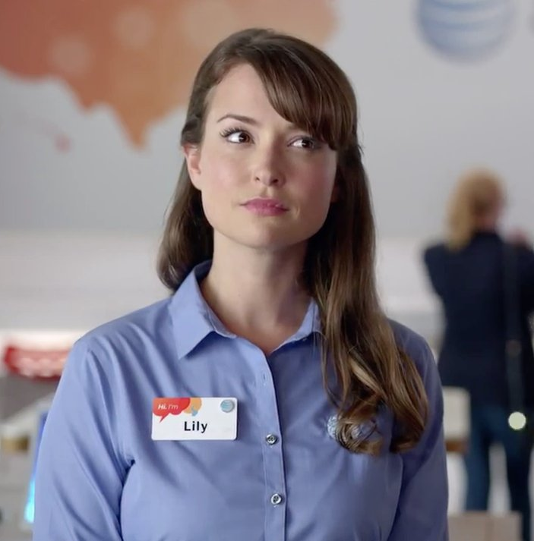
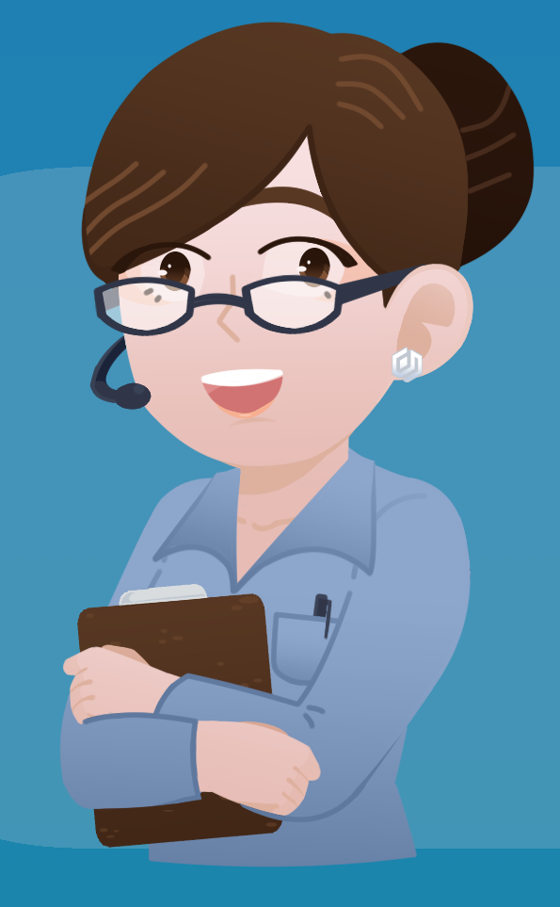
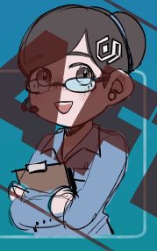

Lily
Key differences/changes to make:
-add pony tail
-more visible eyebrows/less hair/deeper hair part
-longer face/pointed chin (mouth/chin closer to your original)
-taller/longer torso
-ID badge
-eyes some between your original design and the far right sample (big Disney style)
-add buttons on sleeves
-more/deeper shading

